Slide 1
Za Warudo
ITEN03C Final Project (Group 2)

Slide 2

Our Company:
Company name: Za Warudo
Description:
Za Warudo is a business process outsourcing company that specializes in the arrangement and management of schedules and attendance of employees for smaller companies that lack the resources for their own clock-in clock-out system.

Slide 3
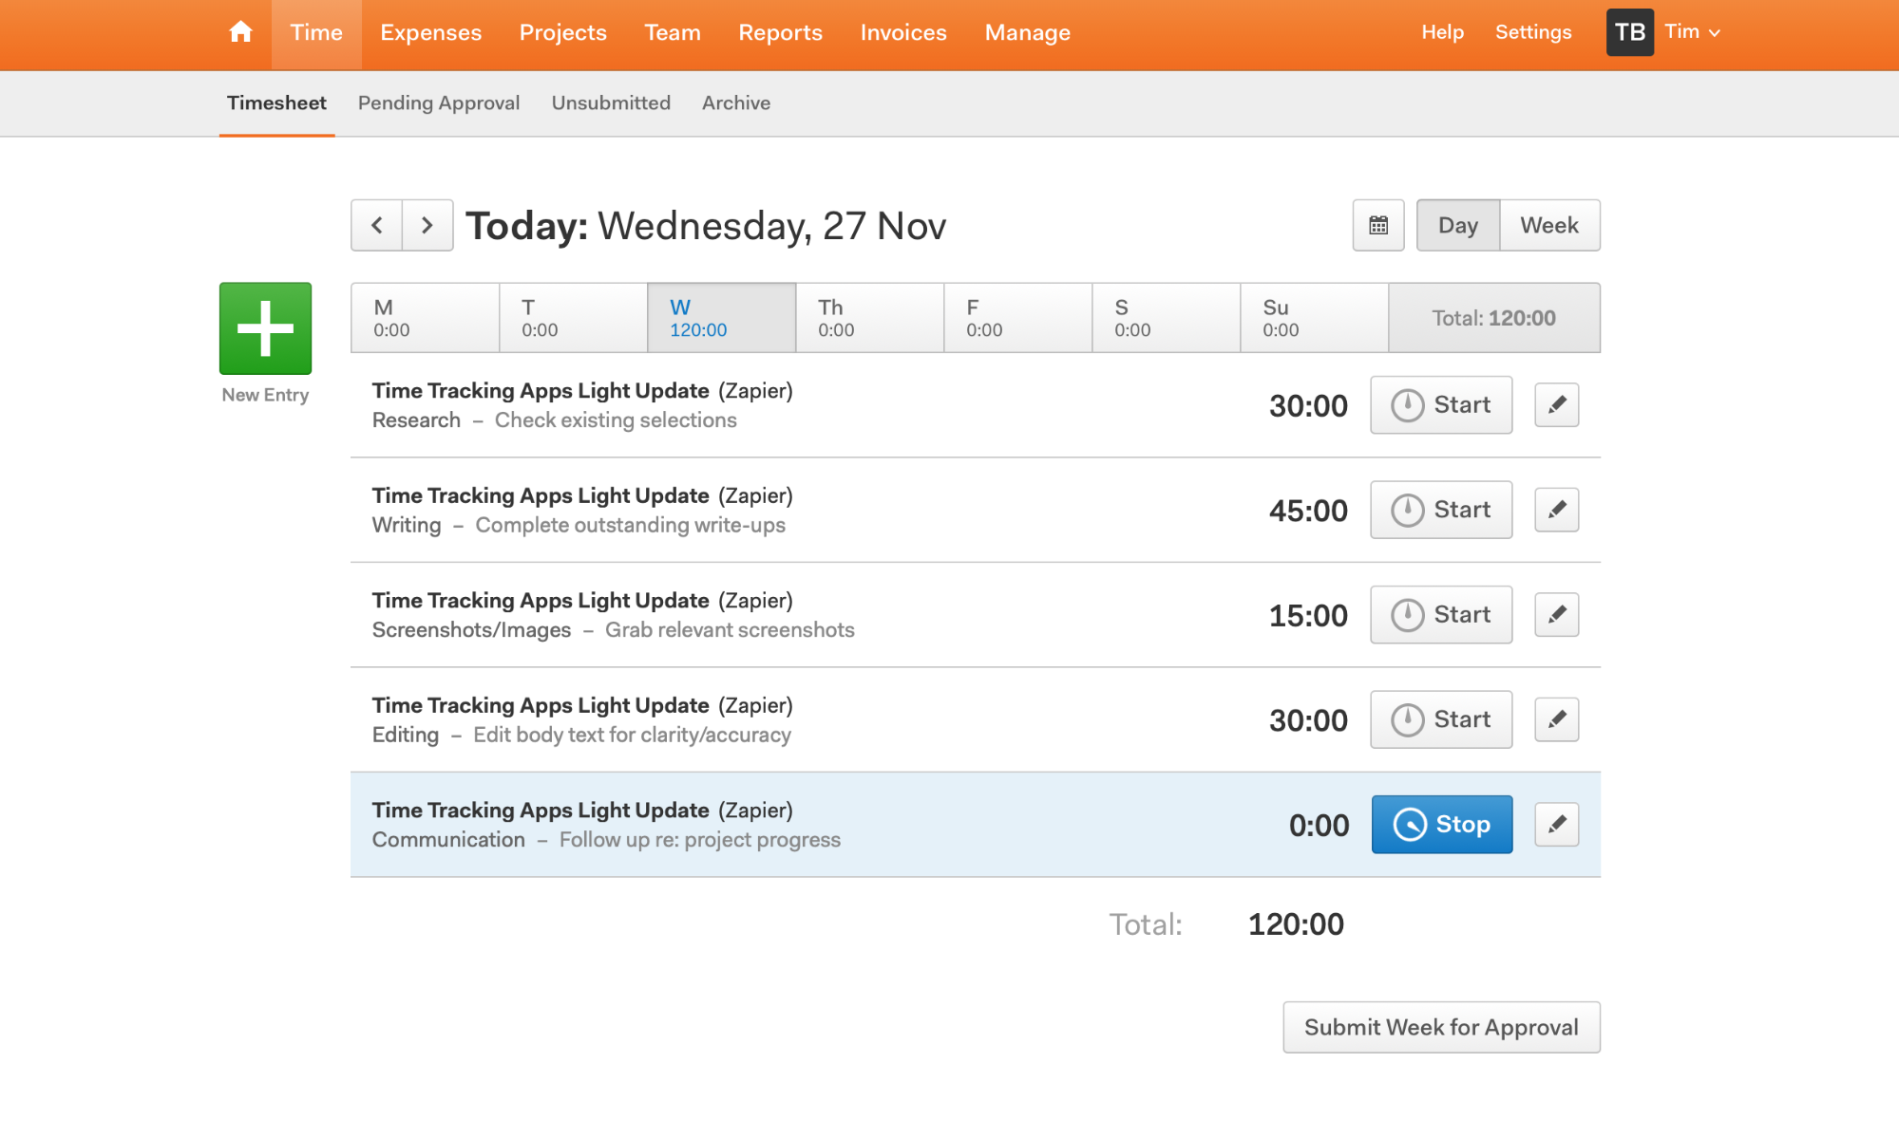
Simple Proposed System
Time Tracking System
Get time-in and time-out input from other company employees
Manage and organize their timesheet
Provide each company with a report of their employee's timesheets

Slide 4
Simple Proposed System
Importance
Source of Income
Provides service to other companies
Department
IT Department

Slide 5
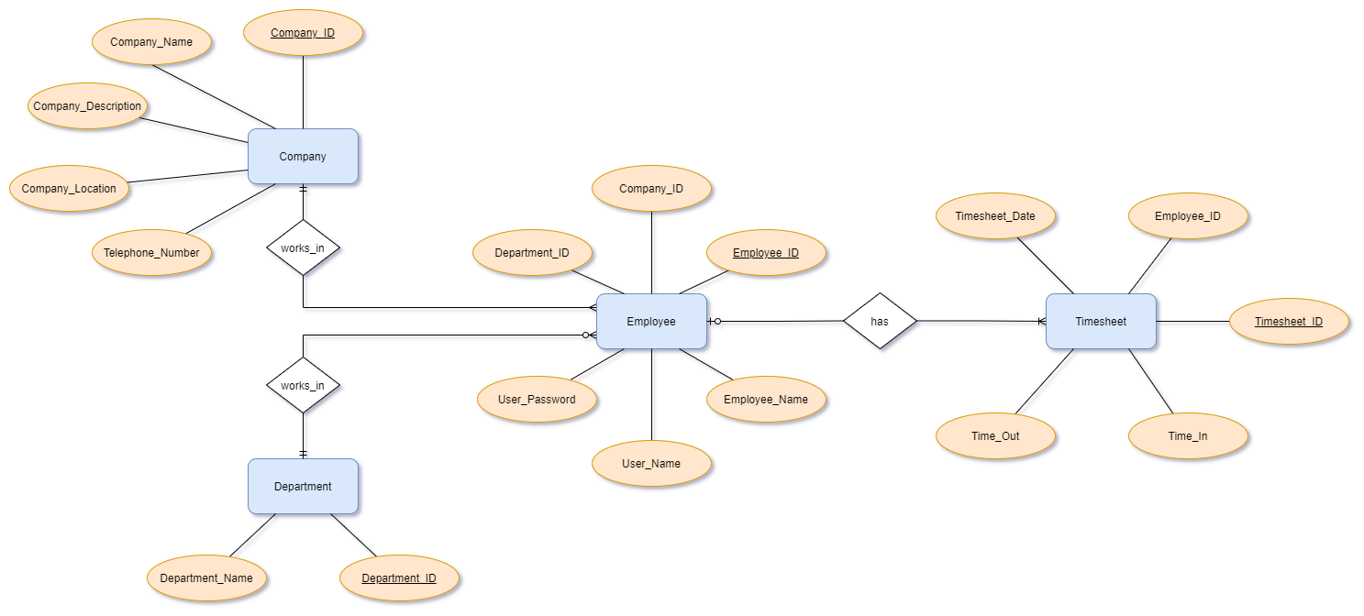
ER Diagram

Slide 6
Company:
Company_ID (Primary Key)
Company_Name
Company_Description
Company_Location
Telephone_Number
Department:
Department_ID (Primary Key)
Department_Name
Employee:
Employee_ID (Primary Key)
Company_ID (Foreign Key)
Department_ID (Foreign Key)
Employee_Name
User_Name
User_Password
Timesheet:
Timehseet_ID (Primary Key)
Employee_ID (Foreign Key)
Timesheet_Date
Time_In
Time_Out

Slide 7
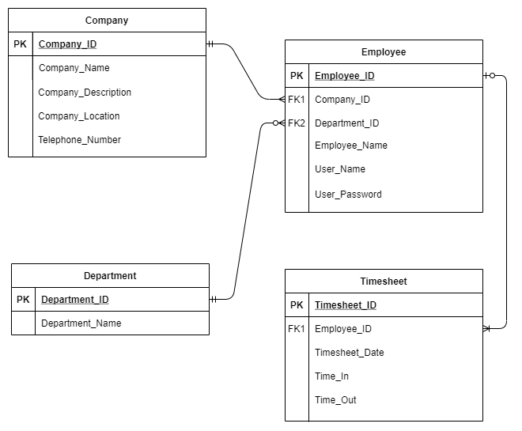
Model Diagram

Slide 8
Company:
Company_ID (Primary Key)
Company_Name
Company_Description
Company_Location
Telephone_Number
Department:
Department_ID (Primary Key)
Department_Name
Employee:
Employee_ID (Primary Key)
Company_ID (Foreign Key)
Department_ID (Foreign Key)
Employee_Name
User_Name
User_Password
Timesheet:
Timehseet_ID (Primary Key)
Employee_ID (Foreign Key)
Timesheet_Date
Time_In
Time_Out

Slide 9
Relationship and Mapping Cardinalities
Works_in
Company
One and only one
Many
Employee
Works_in
Department
One and only one
Zero or Many
Employee
Has
Employee
Zero or one
One or many
Timesheet

Slide 10
Generated Reports

Slide 11
Company Table

Slide 12
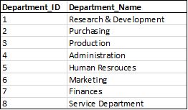
Department Table

Slide 13
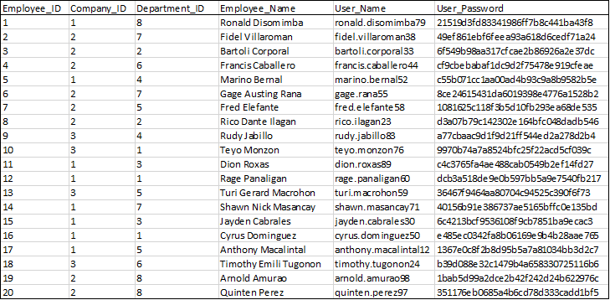
Employee Table

Slide 14
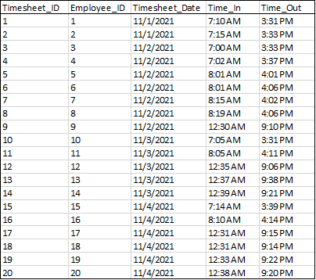
Timesheet Table

Slide 15
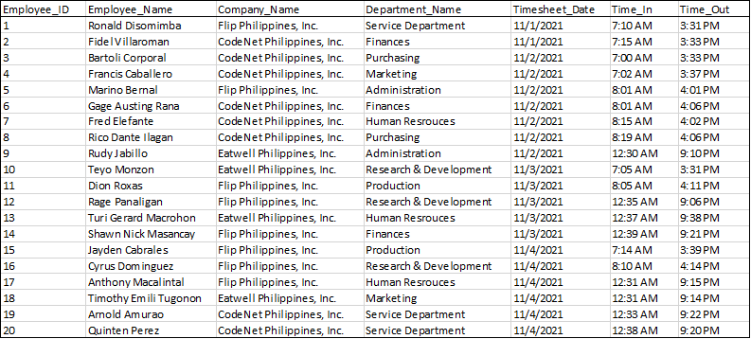
Combine Table

Slide 16
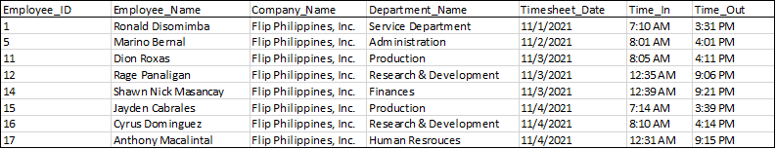
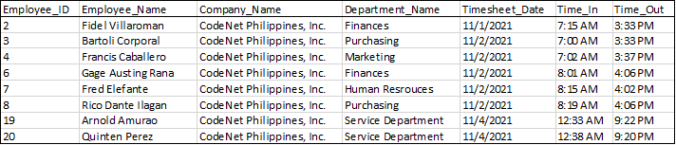

Combine Table (for each company)
Flip Philippines, Inc.
CodeNet Philippines, Inc.
Eatwell Philippines, Inc.

Slide 17
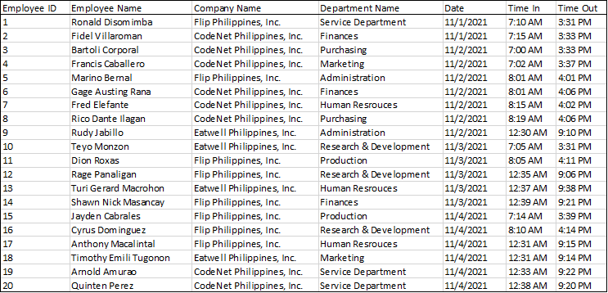
View Table (EmployeeTimesheetView)

Slide 18
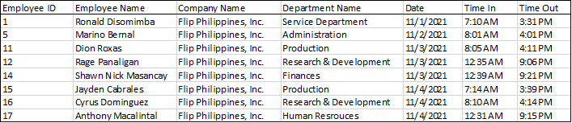
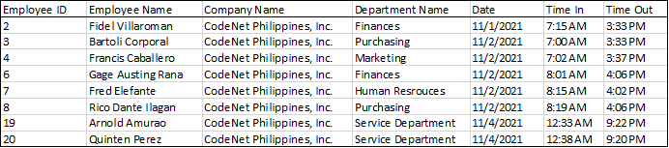

View Table (for each company)
FlipEmployeeTimesheetView
CodeNetEmployeeTimesheetView
EatwellEmployeeTimesheetView

